Slide 1


Slide 2
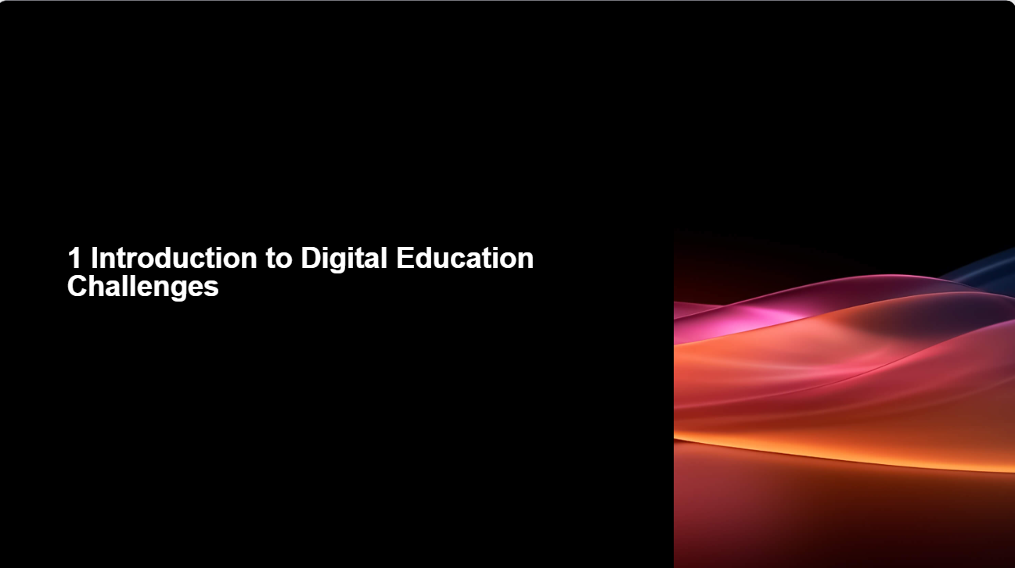

Slide 3
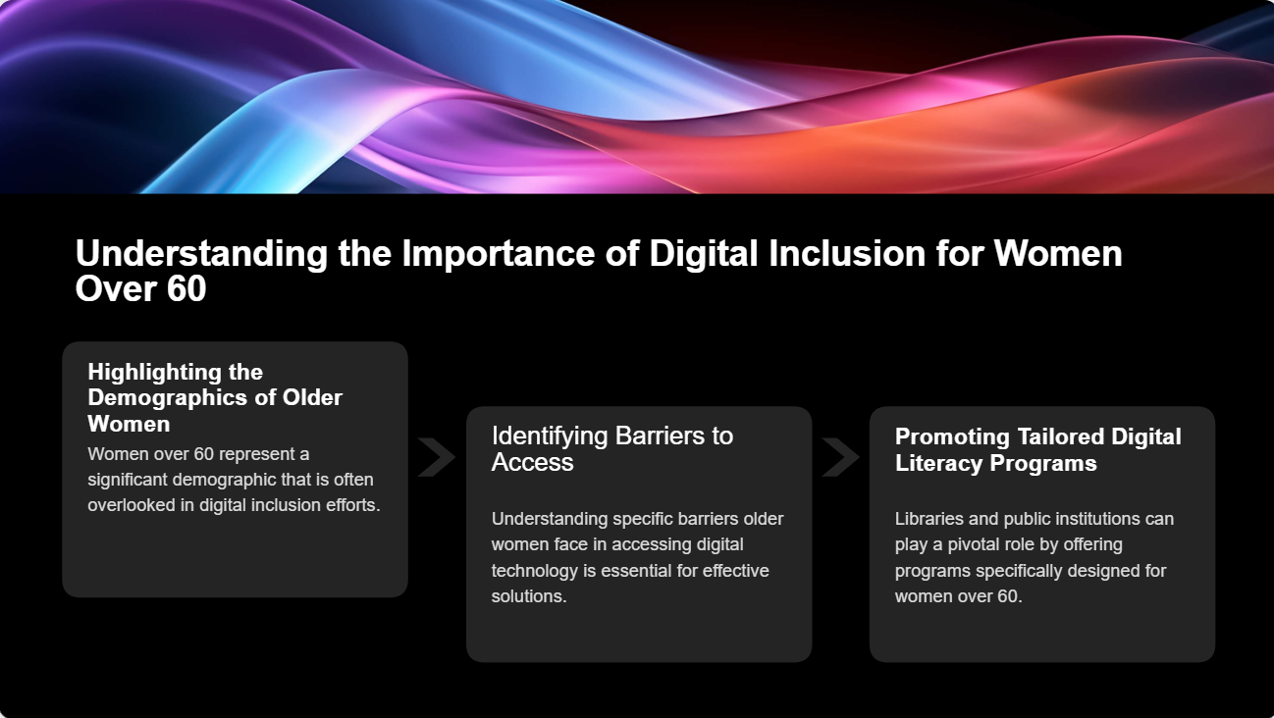

Slide 4
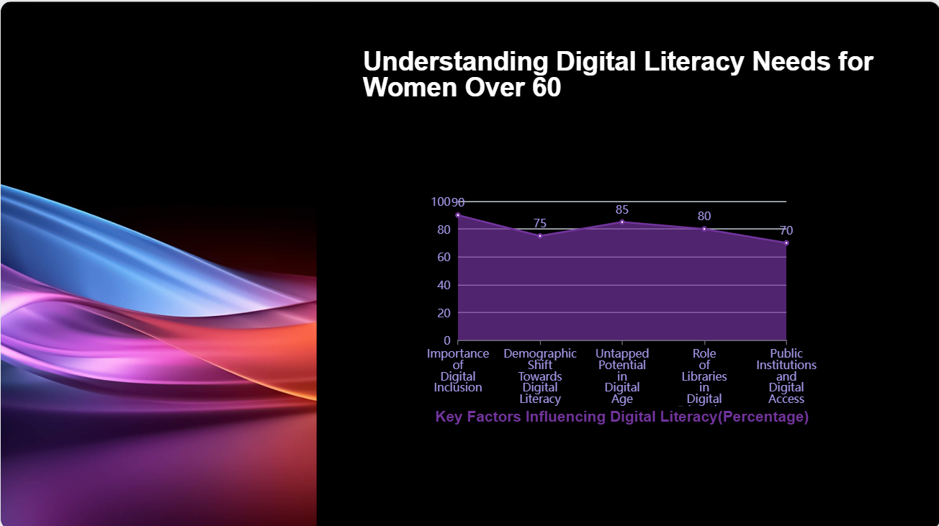

Slide 5


Slide 6
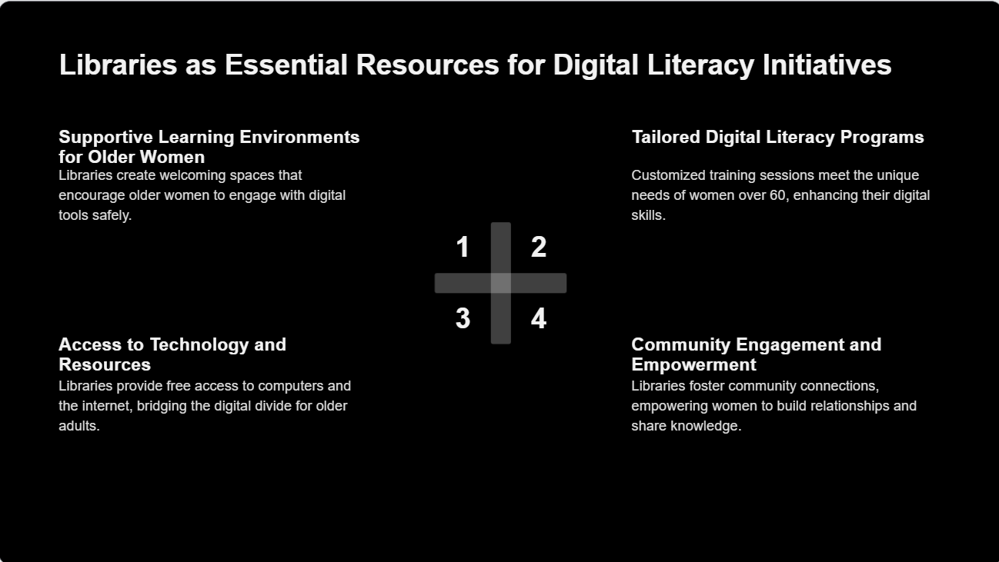

Slide 7
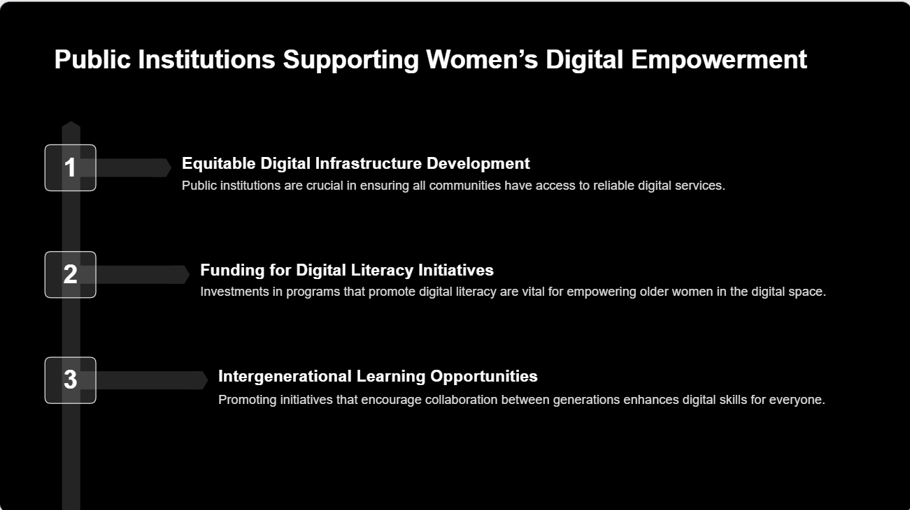

Slide 8
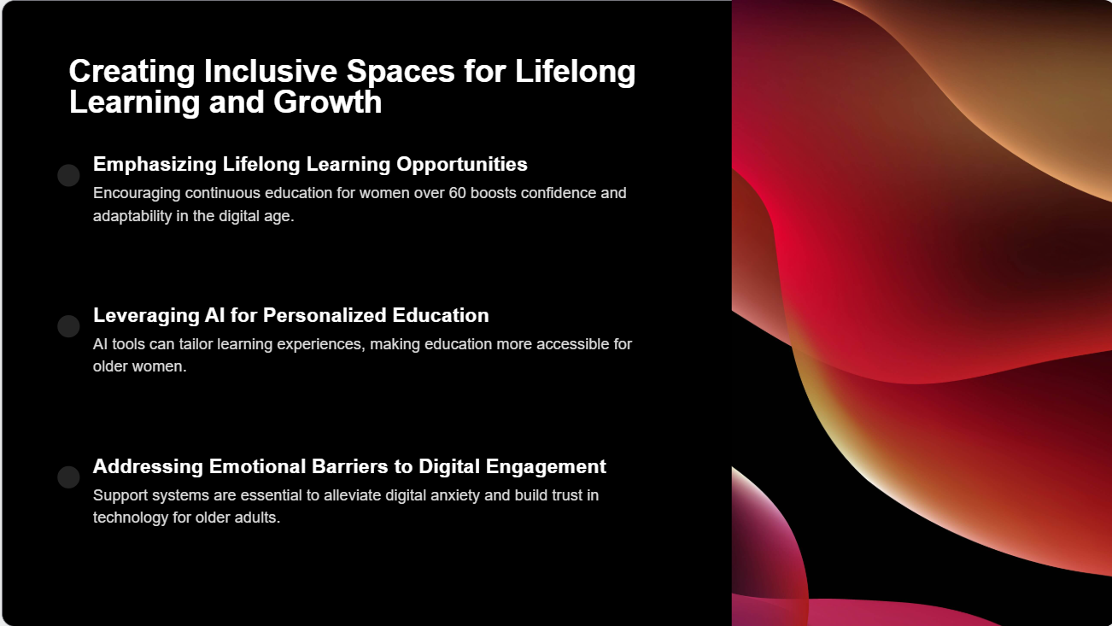

Slide 9
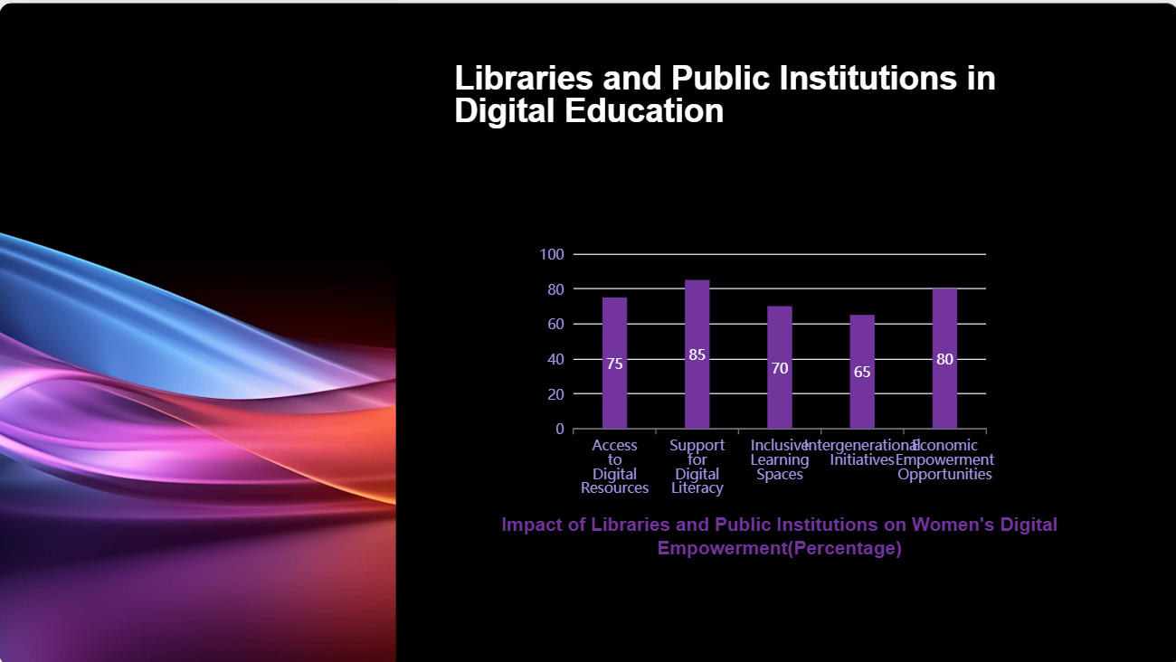

Slide 10
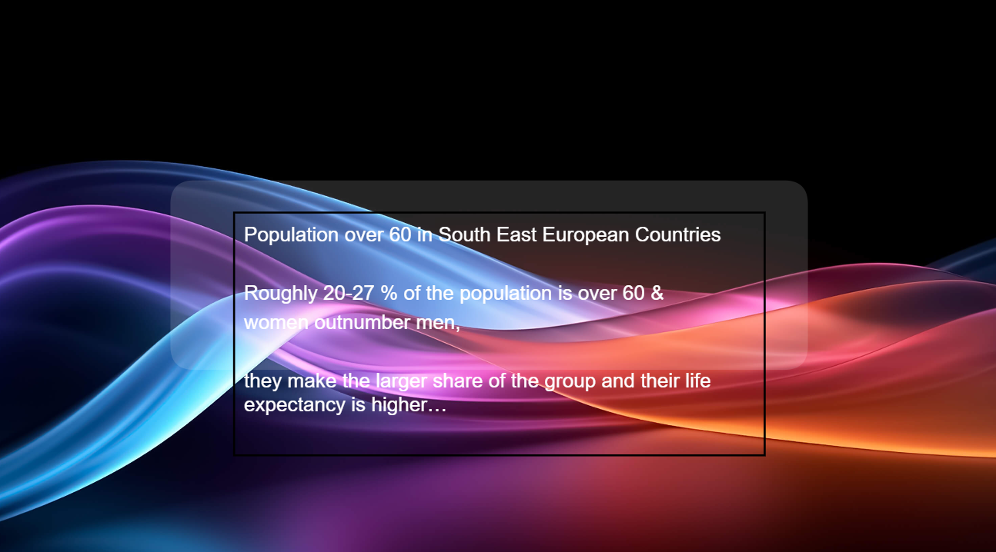

Slide 11

Empowering women over 60 with digital and AI literacy can profoundly enhance:
their personal lives and
enable them to contribute even more meaningfully to their communities

Slide 12
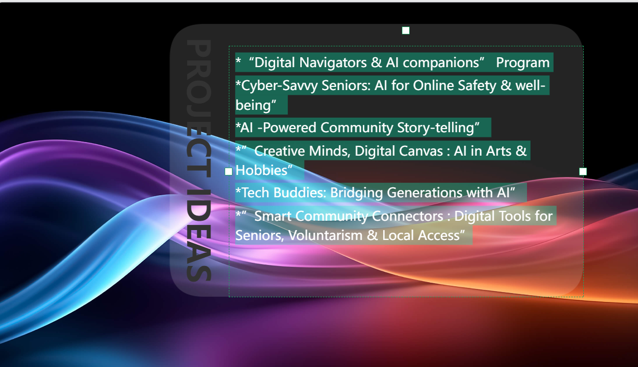

Slide 13

"Silver Sharers: AI-Powered Community Storytelling":
  Concept: A project where senior women learn to use digital tools to document and share their life stories, local histories, recipes, or traditions.
  AI Integration:
    Use AI-powered photo editing/enhancement tools to restore old photos.
    Explore simple AI video creation tools or slideshow makers with AI-suggested layouts.
    Introduce AI transcription services (voice-to-text) to help write down spoken stories.
    Create a simple online platform (blog, private social media group) where these stories can b
    e
    shared.

Slide 14

  Personal Life Benefits:
  Increased independence & confidence online, easier access to information and services, enhanced communication with family/friends, combating loneliness, protection from fraud, better management of personal health information.
  Sense of accomplishment, preservation of personal legacy, creative expression, intergenerational connection if shared with younger family members.
  Cognitive stimulation, discovery of new interests, stress reduction, fun and enjoyment.
  New skills, reduced sense of isolation, feeling valued.

Slide 15
  Community Service Benefits:
  Ability to access community news, participate in online local groups, share information within their social circles.
  Ability to warn peers about online scams, share reliable health information (from trusted sources), and promote safe online practices within their community groups.
  Preservation of local culture and heritage, creating valuable resources for the community, fostering intergenerational understanding.
  Ability to share new hobbies with peers, organize small interest groups, or even create digital art for community events.
  Strengthens community bonds, fosters empathy between generations, youth gain volunteer experience and new perspectives.
  Increased participation in volunteering, better-informed citizens, ability to help peers navigate local digital services

Slide 16

Key Success Factors for Any Project:
Co-design: Involve the target group in planning the projects to ensure relevance and interest.
Patience and Pace: Tailor the learning speed to the participants.
Peer Support: Encourage a collaborative learning environment where women can help each other.
Accessibility: Ensure locations are accessible, and consider providing devices or internet access if needed.
Relevance: Focus on practical applications that directly benefit their daily lives or community interests.
Celebrate Small Wins: Acknowledge progress to build confidence.
Ongoing Support: Offer drop-in sessions or helplines for continued assistance after initial training.
Local Language & Culture: All materials and instruction should be in local language and culturally sensitive.

Slide 17

? ?

