Slide 1



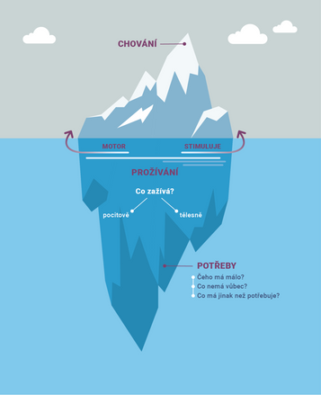
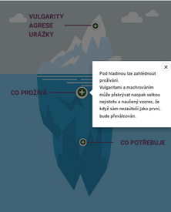
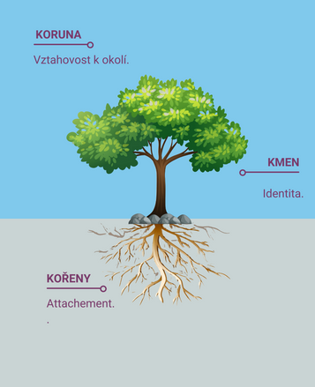
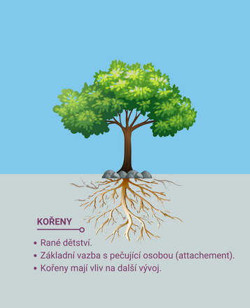
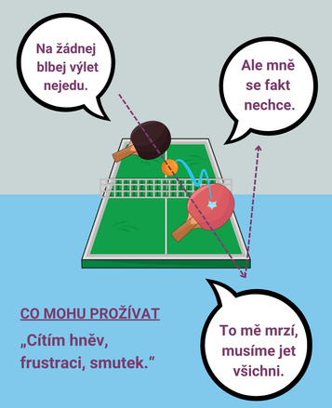
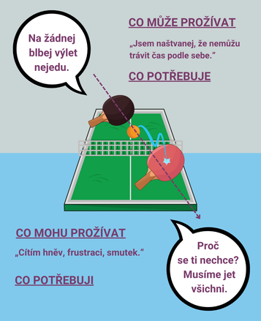





A Child with Challenging Behavior: The Role of Caregivers
Understanding diagnosis, responding with care.
klara.pirklova@npi.cz
katerina.tumova@npi.cz
Who is the e-learning for?
  Educators and caregivers in institutional care facilities.
  Teams seeking to improve trauma-informed practices.
Three guiding metaphors
The course uses three guiding metaphors: the iceberg, the tree, and the game of ping-pong. The iceberg metaphor illustrates what lies beneath challenging behavior. The tree metaphor visualizes child development, trauma, and attachment. The ping-pong metaphor describes the dynamic interaction between children and caregivers. These metaphors are mainly used to simplify complex concepts and prevent cognitive overload.
Course Objectives
  Better understand what is behind challenging behavior.
  Take steps to provide proper help to traumatized children.
  Strengthen supportive role in institutional care.
Creative Process
The course is the result of four facilitated workshops that brought together psychiatrists, psychotherapists, in-service caregivers from institutional care facilities, and learning designers.
During the workshops, we attempted to establish a common language and set of topics that would provide state-of-the-art expertise and comprehensive content.
Learning designers developed the content using Articulate Rise, H5P, and Moodle 4.
The course is being distributed to institutional care facilities in the Czech Republic via the National Pedagogical Institute and the Ministry of Education, Youth and Sports. The impact of the course is continuously evaluated.
Research personified by four characters
Current research shows that most children in institutional care suffer from psychiatric disorders. However, most of these disorders go undiagnosed and are mistaken for misbehavior. The results of the research are presented through the stories of four characters: Patrik, Michal, Ema, and Viola. First, we meet them at their weakest moments. Gradually, their stories unfold. The course concludes when the four characters receive proper help.

